Slide 1




Doctor Go
.Net Web Development Track
By
Amir Mustafa Ibrahim
Ali Issam Abdel Halim
Mohamed Essam Anwar
Mohamed Ashraf Taher
Under the supervision of: Eng. Mohamed Ahmed Sayed

Slide 2
0
Agenda
1
2
Introduction
Objectives
Technologies
Analysis
Features
Design
Future enhancements
overview on the website
3
4
5
6
7
8

Slide 3

0
Doctor Go
1
Introduction
2
3
Project Idea & Our Goal
4
Doctor Go aims to make healthcare more accessible and user-friendly.
5
6
Doctor Go is a healthcare platform built with .NET Core MVC, enabling patients to easily find and book medical appointments. The platform includes features like doctor search, and appointment scheduling to enhance healthcare accessibility.
7
8

Slide 4
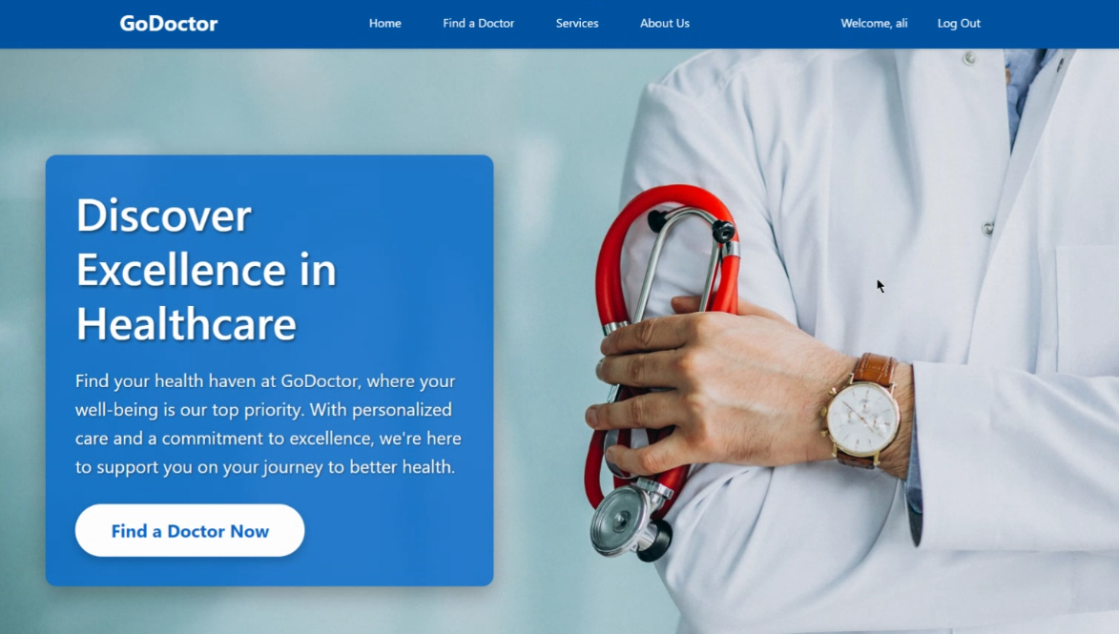
0
Objectives
1
2
The main objectives of Doctor Go are to:
Improve Patient-Doctor Interaction:
Simplify booking and provide easy access to doctors’ profiles for informed decision-making.
3
4
5
Streamline Healthcare Services:
Automate appointment management and
centralize feedback to reduce administrative
burdens and improve efficiency.
6
7
8

Slide 5






Technologies
0
Front-end Technologies:
HTML5: For structuring the web content
CSS3: For styling and layout
JavaScript: For client-side interactivity and dynamic content
Bootstrap: For responsive design and pre-built UI components
Back-end Technologies:
.NET Core MVC: For server-side logic, handling requests, and implementing the Model-View-Controller pattern
Entity Framework Core: For object-relational mapping and database operations
LINQ (Language Integrated Query): For querying data from various sources
Database:
SQL Server: For storing and managing doctor, patient, and appointment data
1
2
3
4
5
6
7
8

Slide 6


Technologies
0
Payment Processing:
Stripe Payment Gateway: For secure and efficient online payment processing
Additional Services:
Email Service: For sending notifications, confirmations, and reminders
Architecture and Design Patterns:
N-tier Architecture: For separation of concerns and modularity
Repository Pattern: For abstracting data access logic
Unit of Work Pattern: For managing database transactions and ensuring data consistency
1
2
3
4
5
6
7
8

Slide 7

Analysis
0
1
Stakeholder Identification
2
Patients
Doctors
Admin
3
………………………………………………………………………..
4
Functional Requirements
1- For Patients:
5
User registration and login
Search for doctors by specialty, location,
View doctor profiles and available time slots
Book appointments
Make online payments
Receive notifications (email)
6
7
8

Slide 8


Analysis
0
1
Functional Requirements
2
2- For Doctors:
3- For Admins:
3
Login To The System
Set and manage availability
View upcoming appointments
Receive notifications for new bookings
Add New Doctor or Admin
Accesses admin dashboard
System Monitoring
4
5
6
7
8

Slide 9
Analysis
User Journey
0
Admin
1
Add Doctor
1
2
Add New Doctors To the System
3
4
2
User Management
5
Accesses admin dashboard
Can Add new Doctor, Add New Admin, And Manage Specialty
6
7
3
System Monitoring
8
System Monitoring

Slide 10
Analysis
User Journey
0
Doctor
1
1
Login
2
Login To the System and Can reset The Default Password
3
4
2
Availability Management
5
Sets up available working dates and times
6
7
3
Appointment Handling
8
Views upcoming appointments in dashboard
Receives a confirmation email for a new Appointment

Slide 11
Analysis
User Journey
Patient
0
1
Registration & Login
1
2
The user visits the platform Clicks on "Sign Up" fills in the required information, and Logs into the system
3
4
2
Doctor Search & Doctor Selection
5
Browses doctor profiles Read reviews and ratings then Select the preferred doctor
6
7
3
Appointment Booking & Confirming payment
8
Views doctor's available time slots Select preferred date and time, Confirms appointment details then Payment Process Enters payment details Confirms payment Appointment then Receives confirmation email

Slide 12
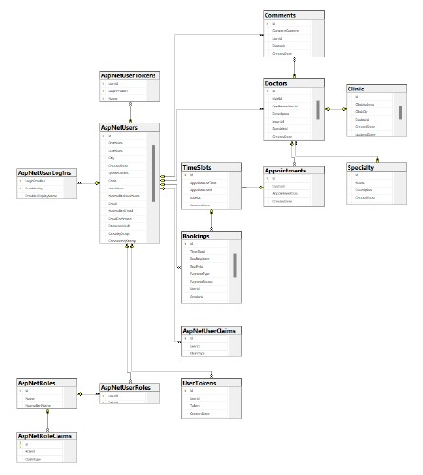
Analysis
ERD
0
1
2
3
4
5
6
7
8

Slide 13
Features
0
1
2
Admin Features
3
User Management
- Add new admin users
- Automatically send email to new admins with account details
- Add new doctors
- Automatically send email to new doctors with account details
System Management
- Add new specialties
- Delete specialties
Doctor Management
- View and manage doctor accounts
4
5
6
7
8

Slide 14
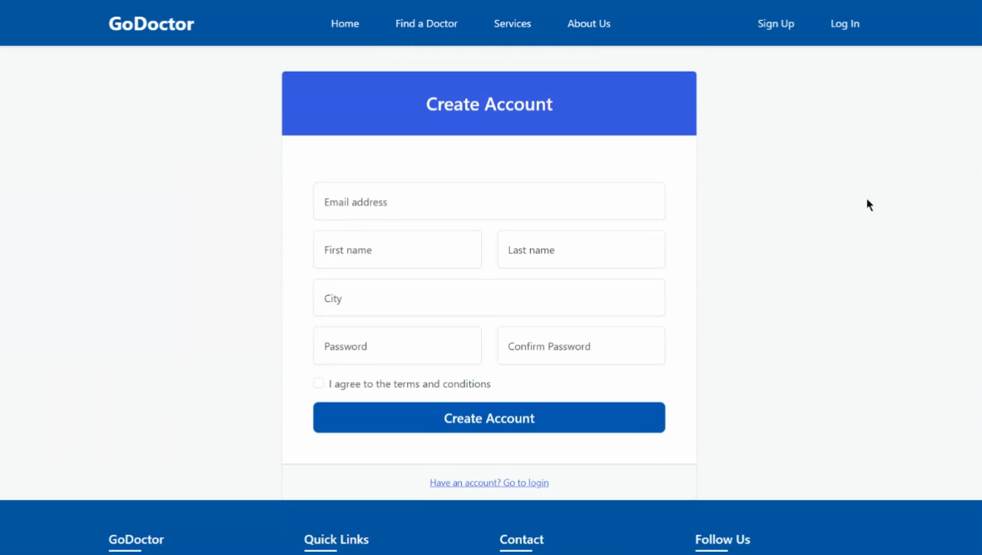
Features
0
User (Patient) Features
1
Account Management
- User registration
- User login
- Password reset functionality
Doctor Discovery
- View all doctors
- Filter doctors by:
- Specialty
- Location
- Name
- View detailed doctor profiles
Appointment Booking
- View doctor's available time slots for the current day
- Book appointments
- Make payments using Stripe payment gateway
Feedback and Interaction
- Add comments to doctor profiles
Notifications
- Receive email notifications for appointment confirmations
2
3
4
5
6
7
8

Slide 15
Features
0
Doctor Features
1
Account Management
- Login to the system
- Reset password (first-time login and forgot password)
Availability Management
- Set available time slots
Appointment Management
- View booked appointments
2
3
4
5
General Features
6
Security
- Forgot password functionality for all user types
Email Notifications
- System sends emails for:
- New doctor account creation
- New admin account creation
- Password reset requests
- Appointment confirmations
7
8

Slide 16
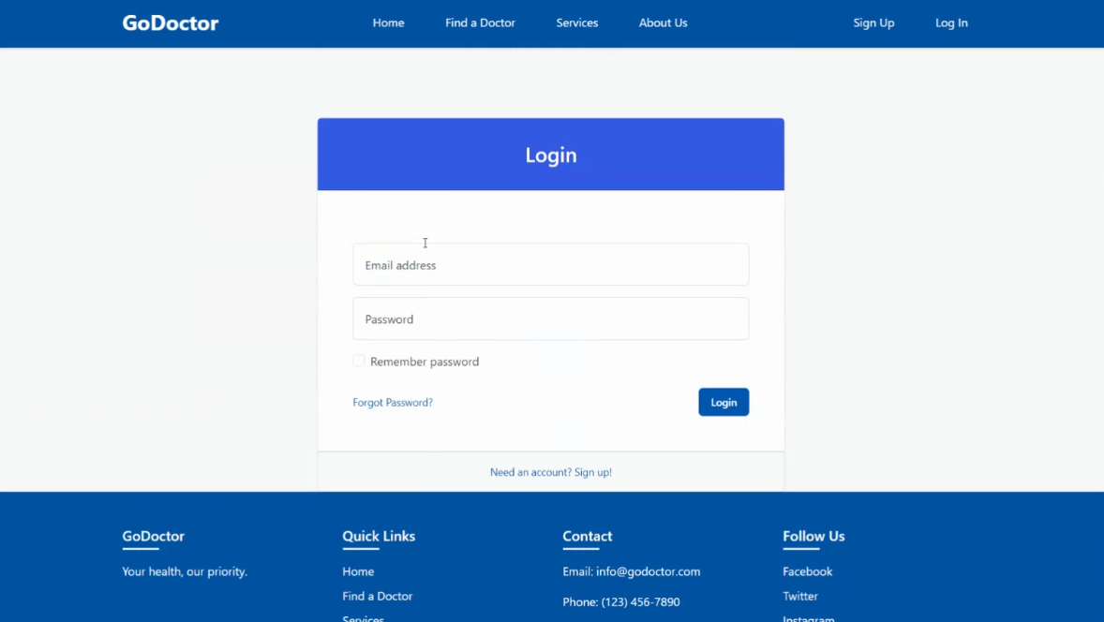
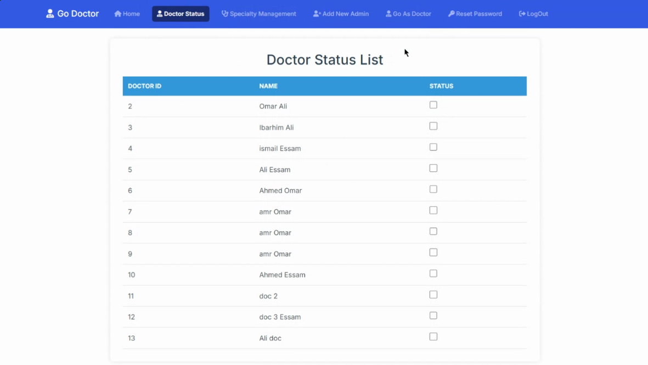
Design
0
1
Home
2
3
4
5
6
Create Account
7
8

Slide 17
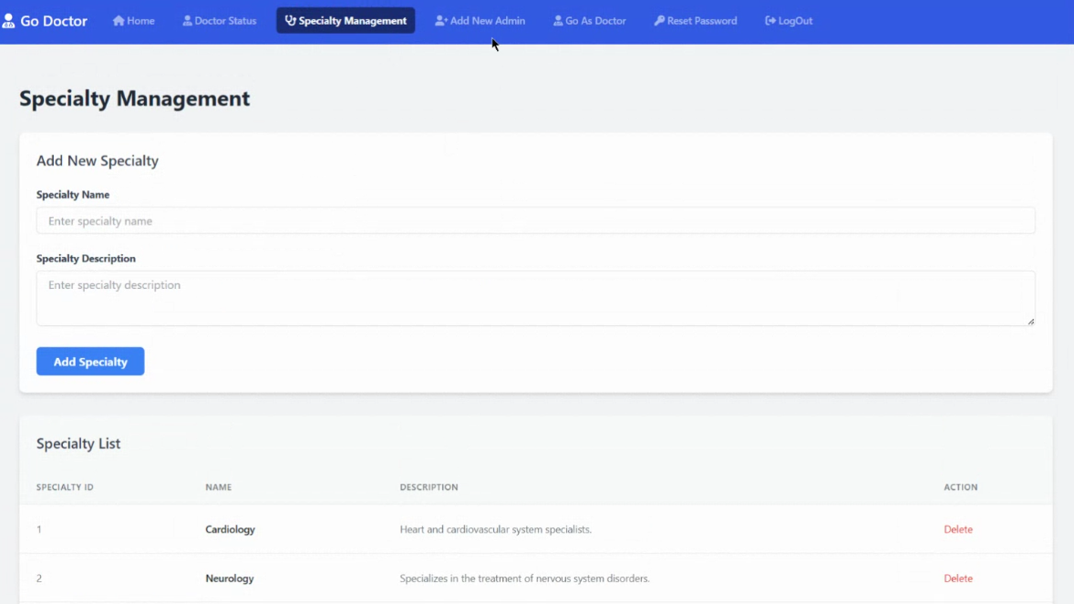
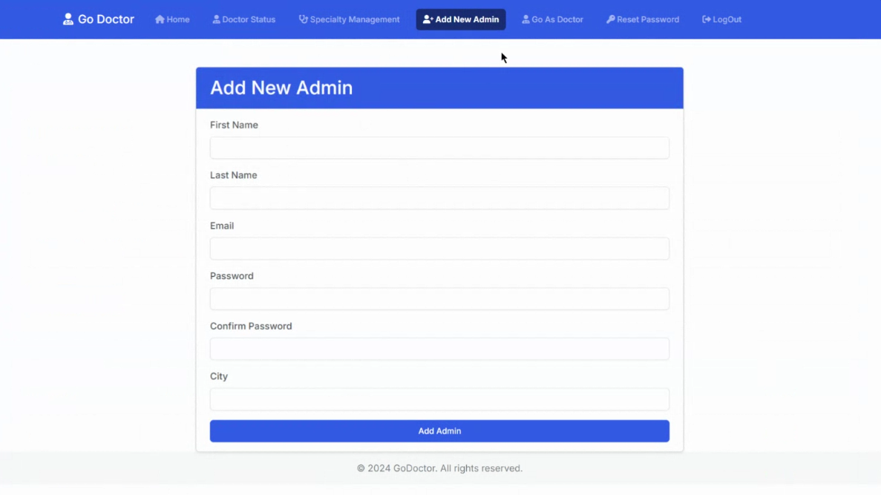
Design
0
1
Login
2
3
4
5
6
Doctor list
7
8

Slide 18
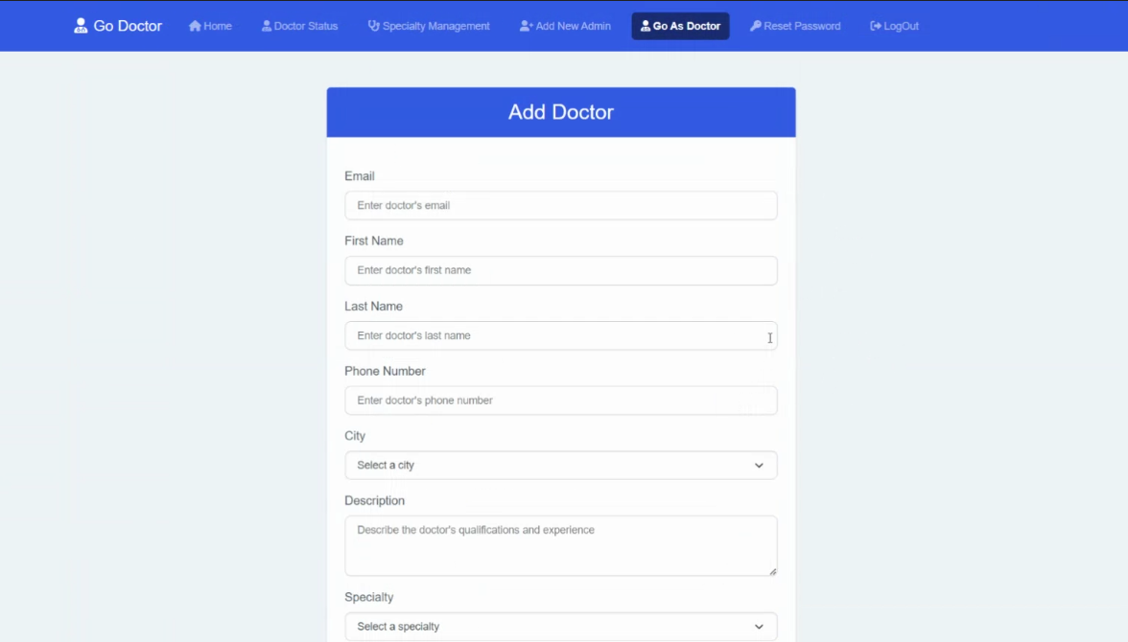
Design
0
1
Specialty
2
3
4
5
6
Add new
Admin
7
8

Slide 19
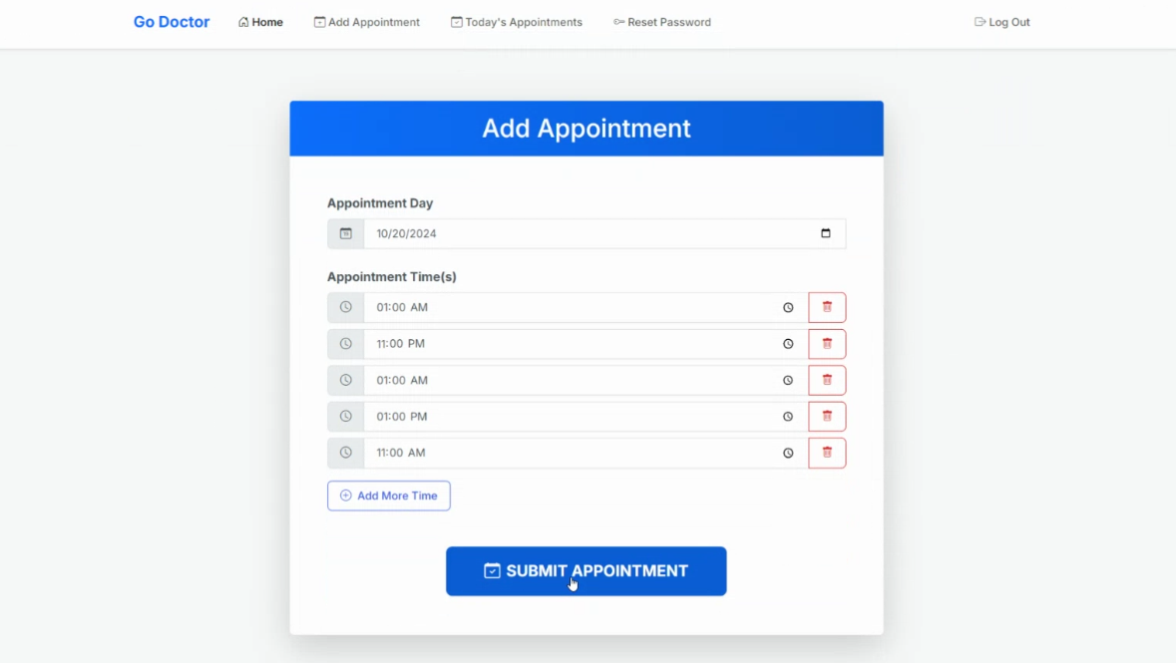
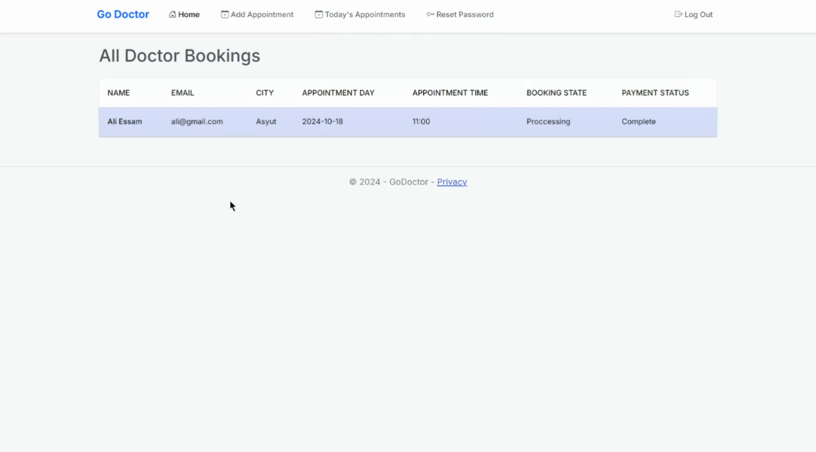
Design
Add Doctor
0
1
2
3
4
5
6
7
8

Slide 20
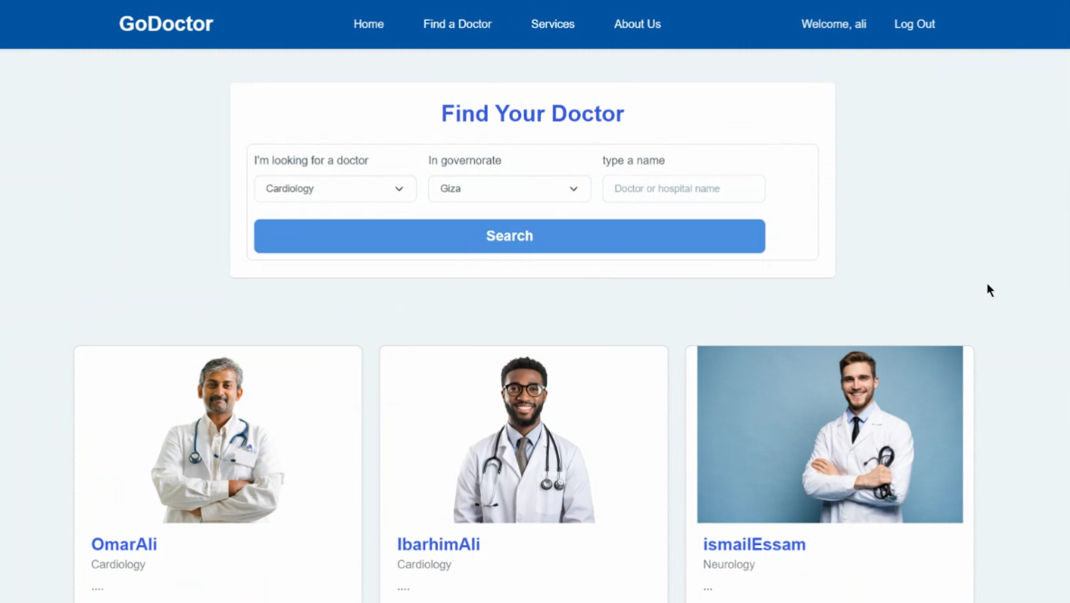
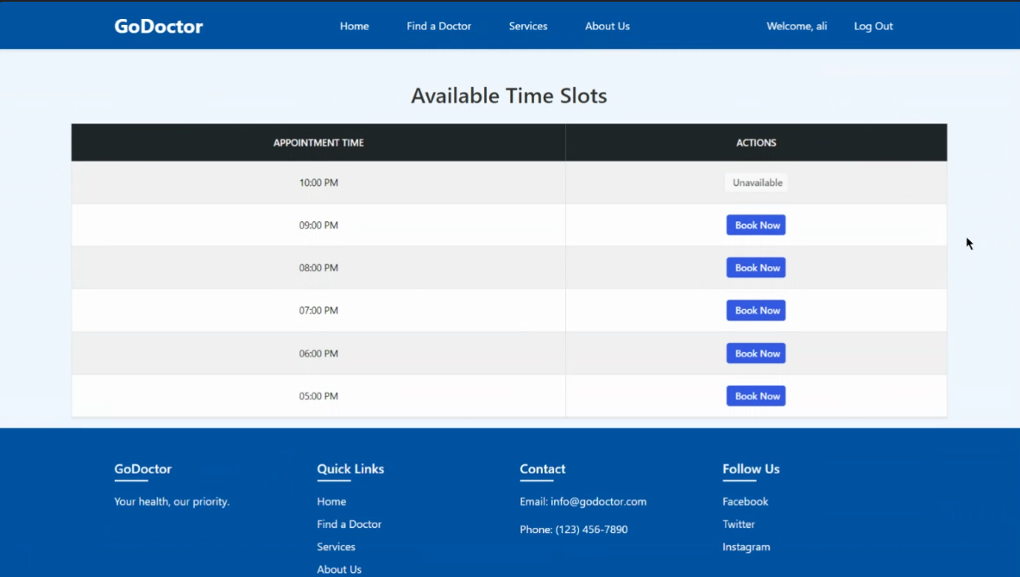
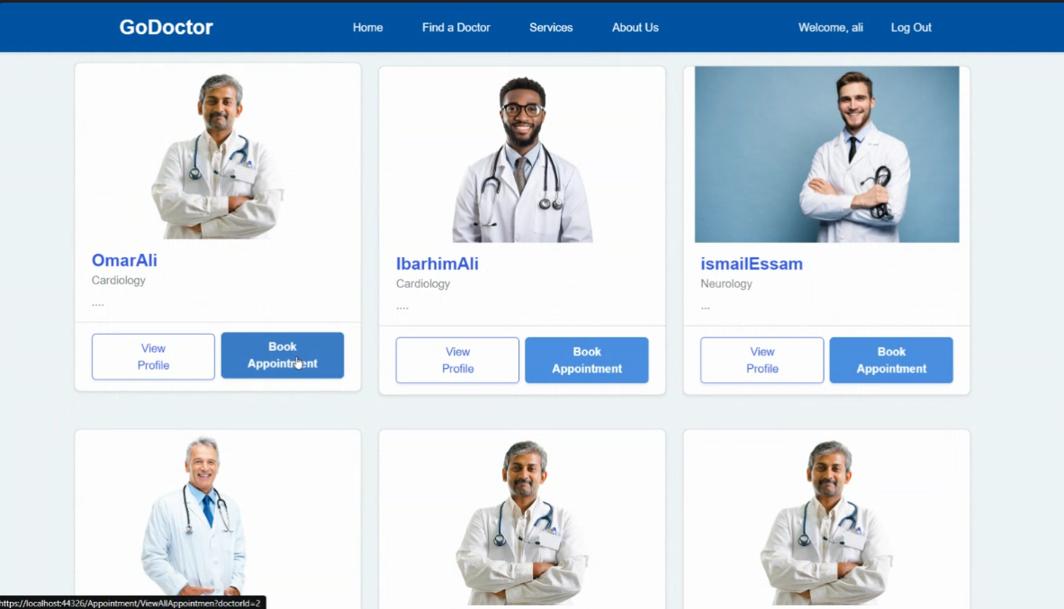
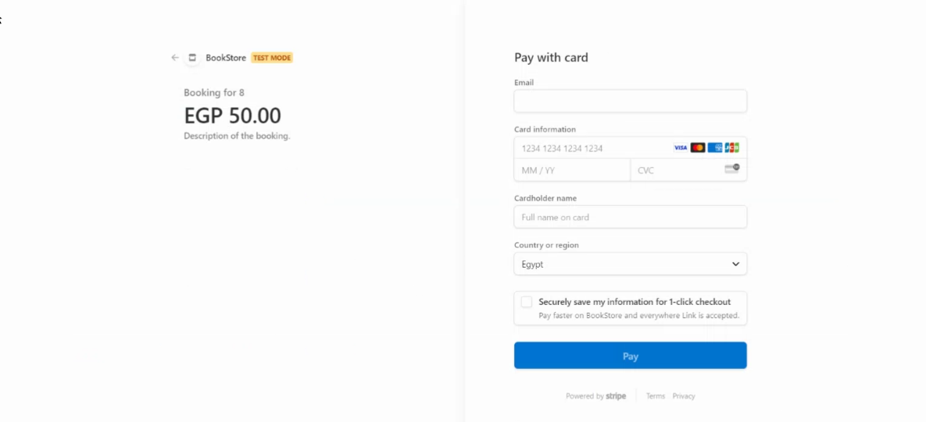
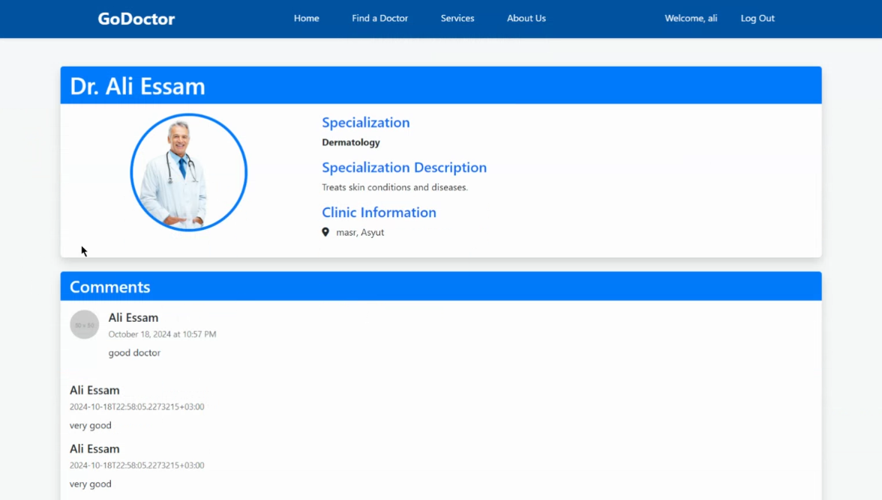
Design
0
Add
Appointment
1
2
3
4
5
6
Booked
Appointments
7
8

Slide 21
Design
0
Find
A Doctor
1
2
3
4
5
6
View Profile
Or Book
7
8

Slide 22
Design
0
1
Doctor Details
2
3
4
5
6
Available Appointments
7
8

Slide 23
Design
0
Confirm And Pay
1
2
3
4
5
6
7
8

Slide 24
Future Enhancements
0
1
Social Media Integration:
2
Allow sign-up and login using Facebook or Gmail accounts
Enhances account security:
3
Multi-Factor Authentication (MFA): Options may include SMS codes, authenticator apps, or biometric verification
4
Telemedicine Services:
5
Implement telephone and video consultation features
Provides flexibility for patients and doctors
6
Advanced Customer Support:
24/7 AI Chatbot: Implement an intelligent chatbot for round-the-clock support Answers basic health queries
7
Improved Administration and Doctor Management:
Enhanced Admin Controls: Allow admins to suspend doctor accounts when necessary Ensures quality control and patient safety
Self-Registration for Doctors: Enable doctors to sign up and upload credentials Streamlines the onboarding process Doctors await admin verification before becoming active on the platform
8

Slide 25
Future Enhancements
0
1
Flexible Payment Options:
2
Cash Payment Alternative: Allow users to pay for appointments in cash
Marketing and Visibility Features:
3
Doctor Advertising System: Allow doctors to feature prominently in specific areas Creates a new revenue stream for the platform
4
Dual Clinic Management:
5
Allow doctors to manage appointments at two different clinic locations
Working with Labs and Pharmacies:
6
Team up with Medical Labs and Pharmacies: Work together with places that do medical tests and sell medicines
Makes our platform a one-stop shop for health needs
Helps patients easily book tests and get medicines
7
Regular Health Check-up Packages:
8
Offer plans for patients to get regular health check-ups
Gives our platform a steady income and keeps patients coming back

Slide 26
0
1
2
3
Overview On The Website
4
5
6
7
8

Slide 27
Doctor Go
0
1
2
Thank you
3
4
5
6
7
8

